Slide 1
BLYNK
​

Slide 2


Team numbers
T
2110040001_Harish 2110040011_Karthik Yadav 2110040019_Sai Lakshman 2110040040_Vishwas 2110040046_jathin 2110040060_Bharath kumar

Slide 3
Introduction
Road accidents became a matter of concern due to the huge increase in traffic. The primary cause of accidents is due to the drowsiness of drivers in the nighttime. Fatigue and drowsiness are some of the leading causes of major accidents on Highways. The only solution to this problem is detecting the drowsiness and alerting the driver..

Slide 4
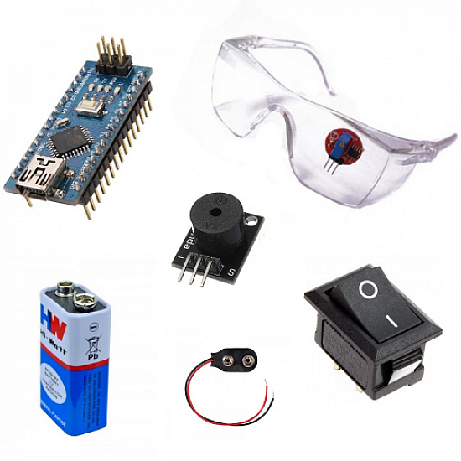
REQUIREMENTS
Arduino UNANO
9V battery
Switch
Buzzer
Eye blinking sensor
Smart glass

Slide 5
Eye Blink Sensor :
This sensor module consists of the eye blink sensor frame, the IR sensor and a relay.
The vibrator device is connected to the eye blink sensor frame which is to be worn by the driver.
This vibrator vibrates whenever an accident occurs or the driver falls asleep.
The frame consists of the IR transmitter which transmits the IR rays towards the driver’s eyes and an IR receiver which receives the reflected rays when the eyes are closed.
The relay provides the extra current required by this module and hence is also connected to the SST microcontroller board .

Slide 6
Code used on Arduino :
<p>int Sinput = A1;
{
</p><p>pinMode(Sinput, INPUT);
}
void loop()
{
if(digitalRead(Sinput)==LOW)
{
delay (2000);
digitalWrite(Buz, HIGH);
}
else
{
if(digitalRead(Sinput)== HIGH)
{
digitalWrite(Buz, LOW);
}
}
}

Slide 7
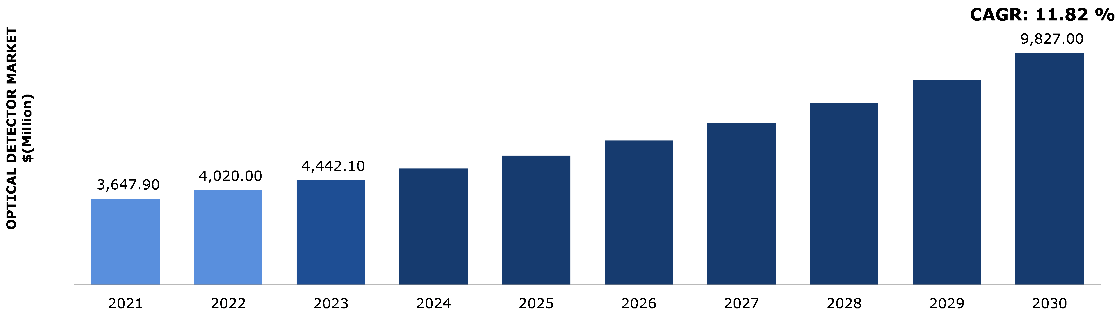

Market Overview
The global eye tracking market size was valued at USD 631 million in 2021 and is expected to reach USD 8407.63 million in 2030 expanding at a compound annual growth rate (CAGR) of 33.34% from 2022 to 2030.

Slide 8
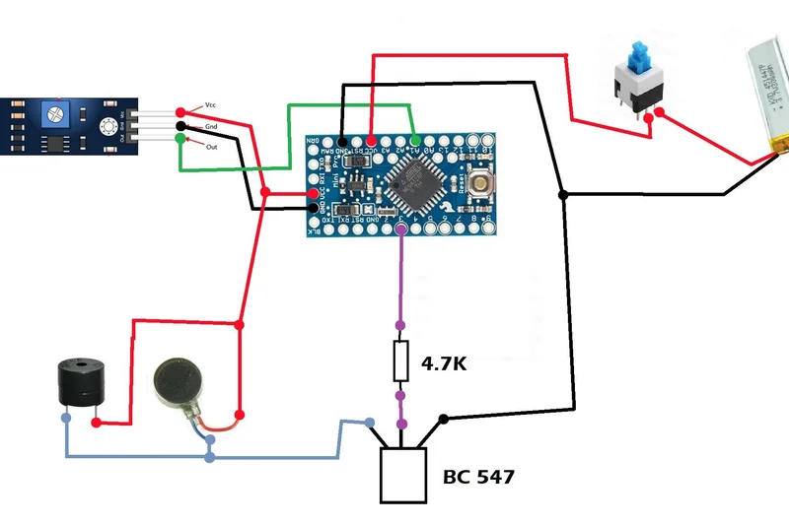
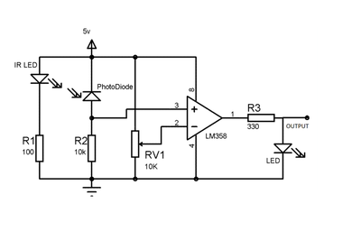
Block diagram

Slide 9
The photo diode is placed just next to the IR LED in such a way that it can not receive IR rays directly. Photodiode is sensitive to the IR radiation. It's cathode connected to the positive voltage i.e. 5volt and anode connected to the noninverting input of the Opp-amplifier which also get pulled down though the 10Kilo ohm resistor. Potentiometer in IR sensor is use to set the sensitivity distance of the sensor, it connected to the inverting input of the Opp-amplifier. IR LED continuously transmit the infra red rays and if any object comes in front of it, IR rays get reflected back and it received by the photo diode due to this change in IR radiation the voltage at the anode get change, the change in anode voltage is depend on the IR radiation received by the photo diode. More the IR radiation received grater will be the change in anode voltage. The output of the IR Sensor taken from the output of the Opp-amplifier. We can adjust the sensitivity distance by rotating the potentiometer on the sensor, we rotate the potentiometer that means we set a threshold voltage for the noninverting input of the Opp-amplifier. Whenever the voltage on the noninverting input is greater than the threshold voltage, the voltage on the noninverting input i.e. +ve voltage from the photodiode get forwarded and get the positive pulse at the output of the Opp-amplifier i.e. output of the sensor.

Slide 10
conclusion
The idea of eye control is of great use to not only the future of natural input but more importantly the handicapped and disabled. One of the main goals for Eye Tracking Interpretation System is to enable completely paralyzed patients to make their life more accessible and to provide them opportunity of independence and movement.According the our studies this project is feasible.

Slide 11

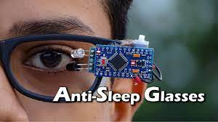
Thank you

